Slide 1
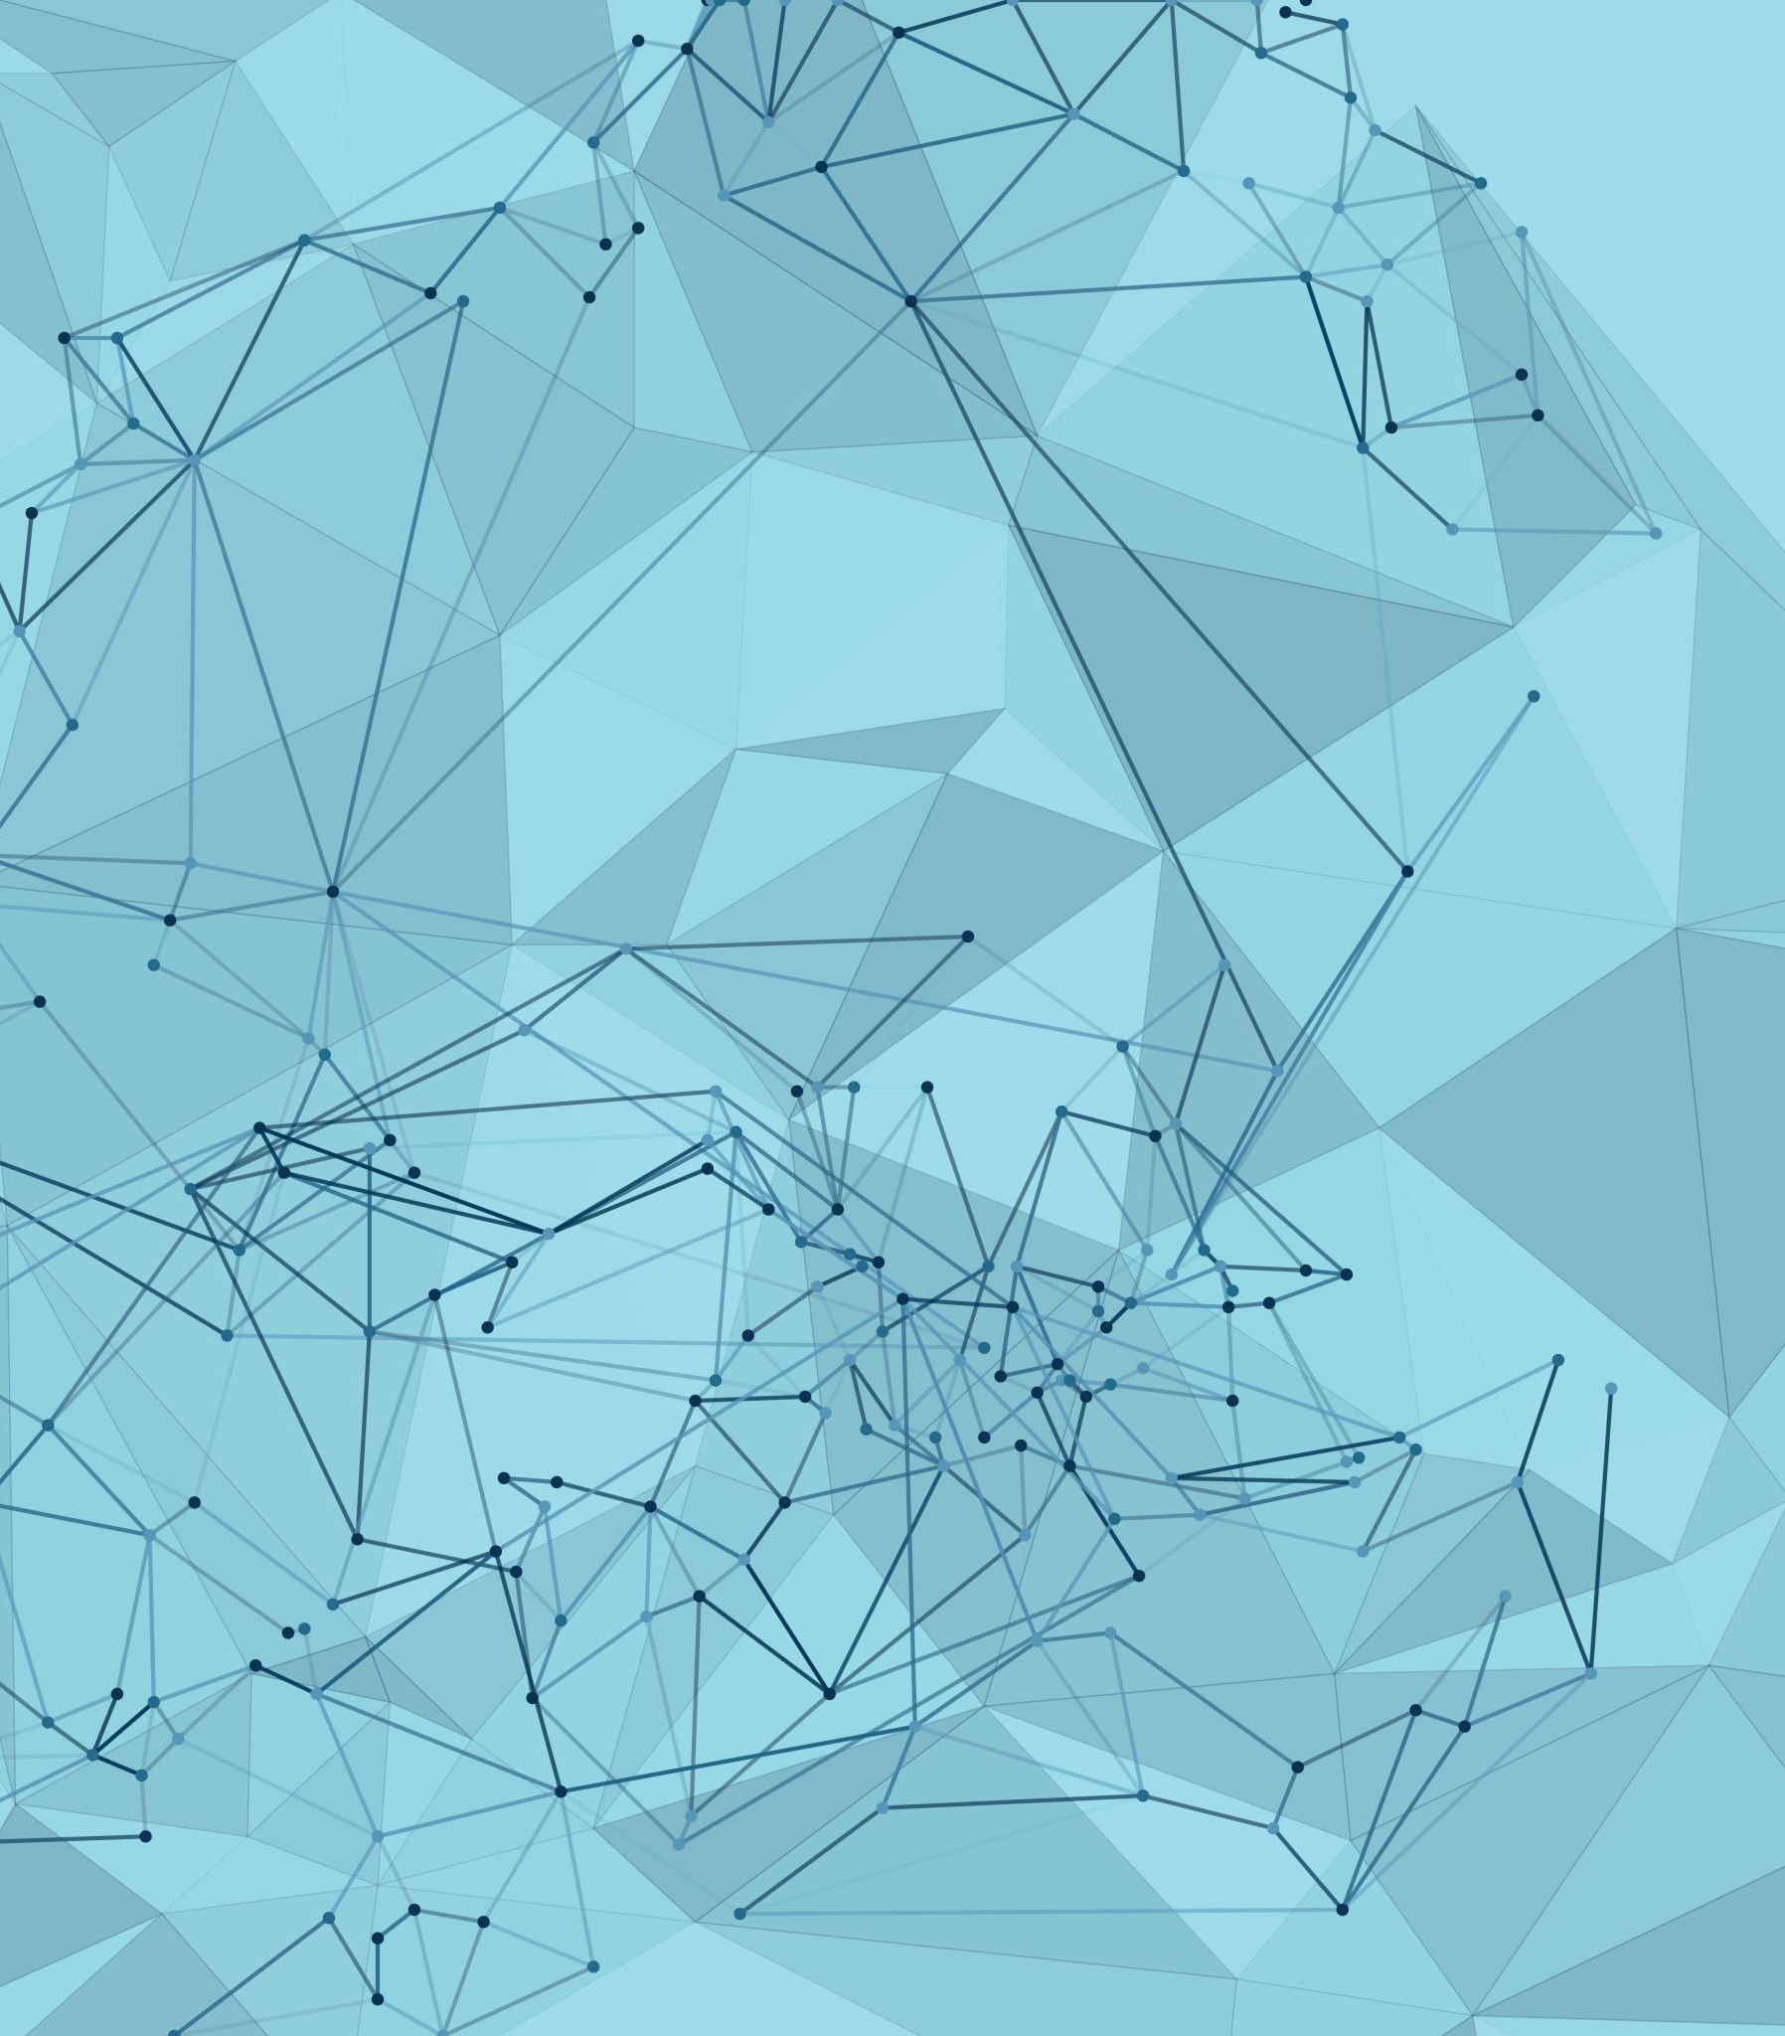
Sign language glove
By Muhannad Hamdy
& Ayman Awad

Slide 2

It can help making deaf people's life better
This glove prints some previously programmed messages depending on the movement of person's fingers or the shape this person is making by his fingers

Slide 3
Drivers used
ADC
LCD
DIO

Slide 4

Product Structure
Glove
The glove consists of 5 bendable resistors that act as sensors for the fingers movements.
The bending translates to voltage change which the microcontroller reads.

Slide 5
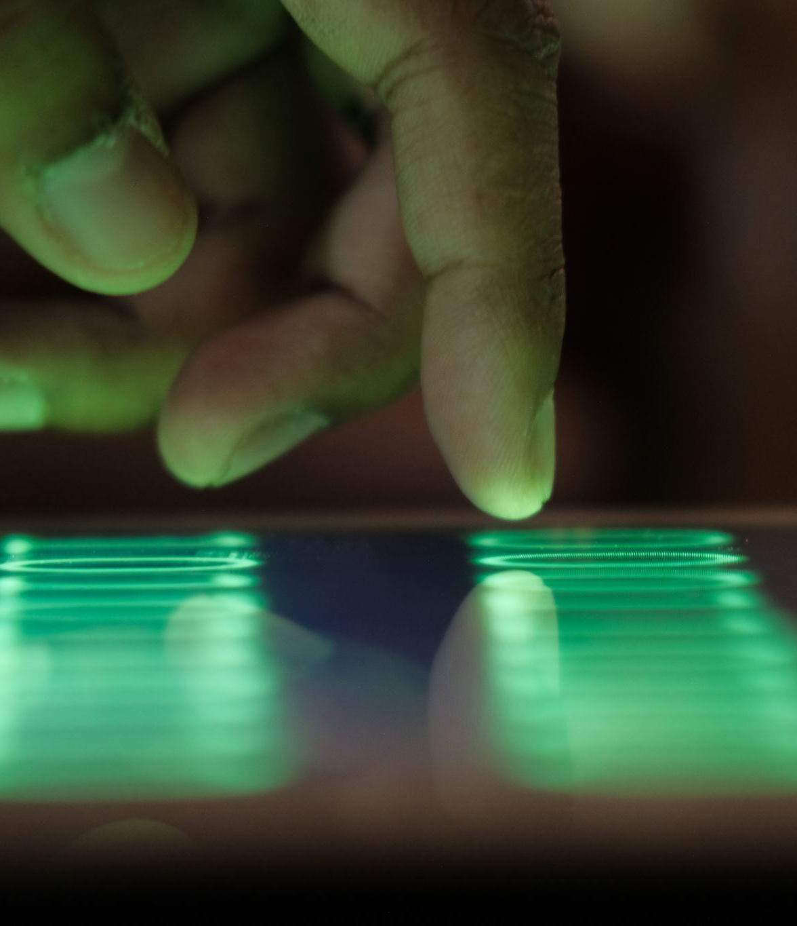
Product Structure
LCD
Prints message depending on the fingers position.

Slide 6
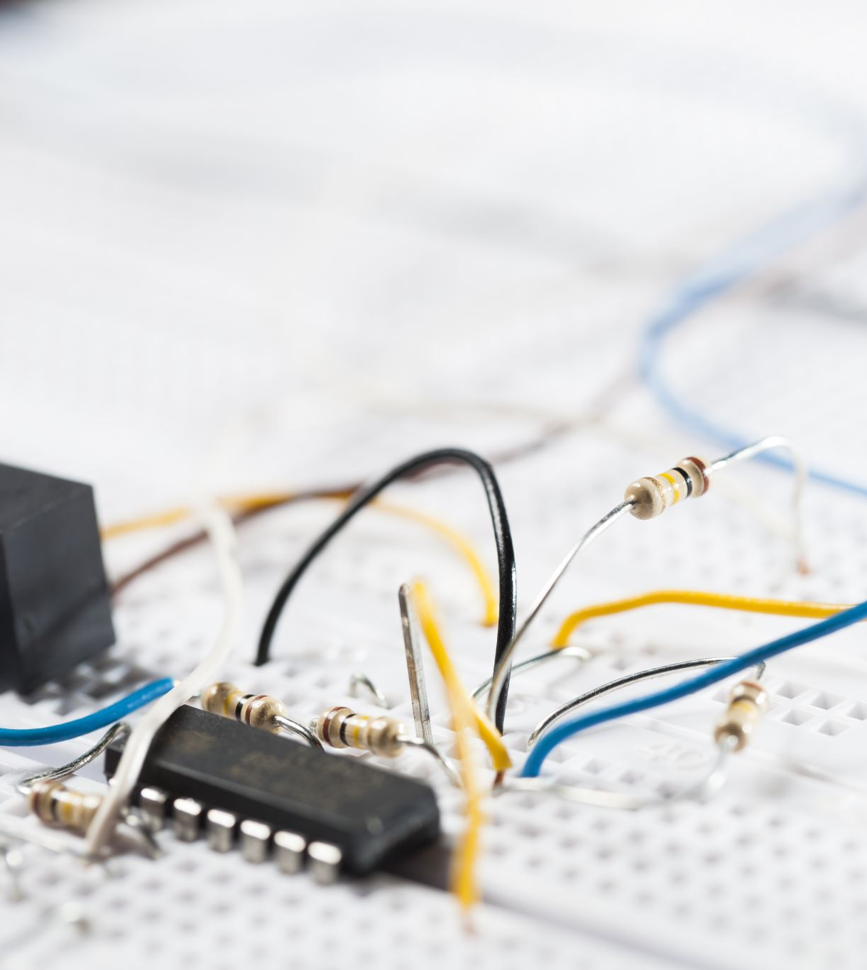
Product Structure
ATMEGA-32
The logic handling microcontroller that connects all of the components together.

Slide 7
Thank you

